Slide 1
Journaley
Presentation
Marwa Khalid Felix Wong

Slide 2

Presentation Order
Date
1
2
3
4
5
Demo
Code Review
Architecture Diagram
ER Diagram
Sequence Diagram

Slide 3
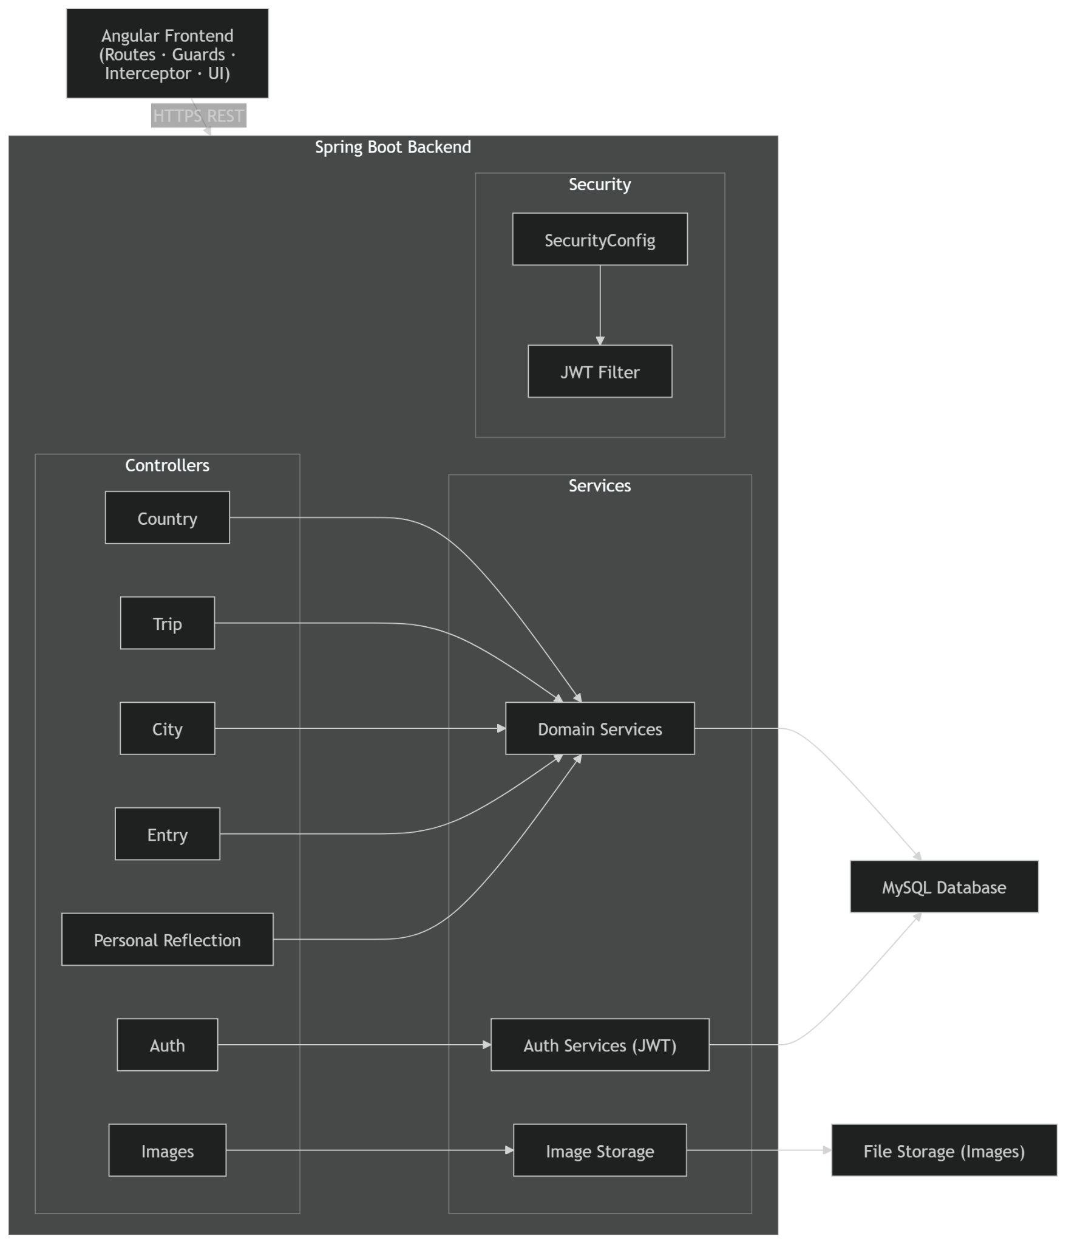
Architecture Diagram

Slide 4
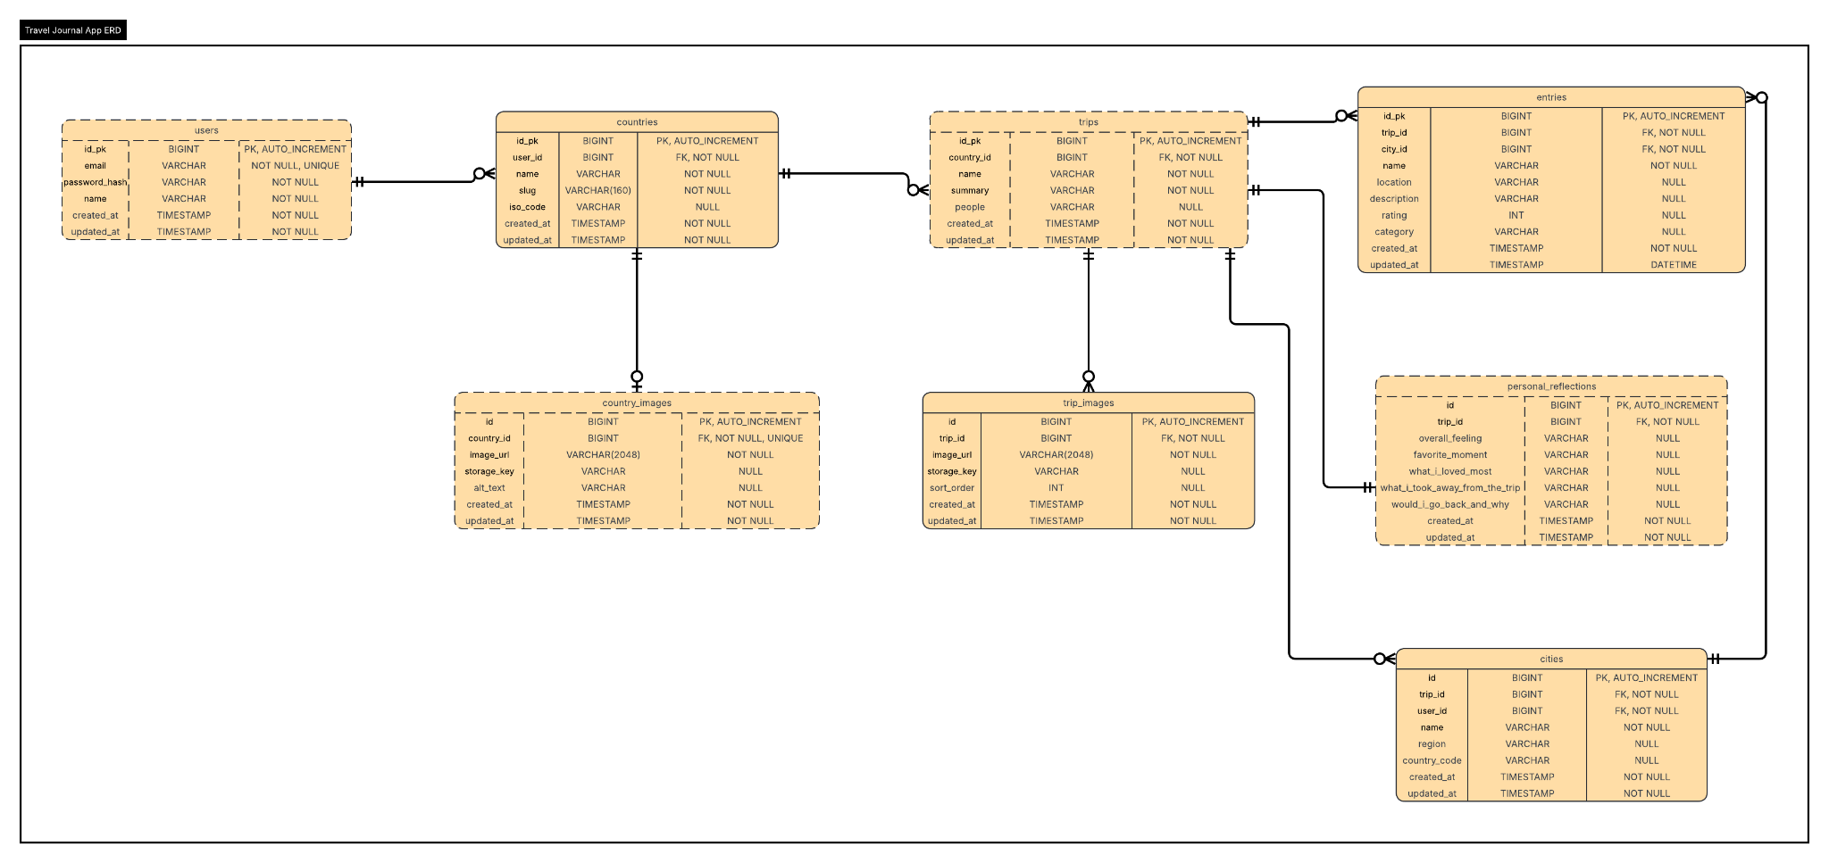
ER Diagram

Slide 5
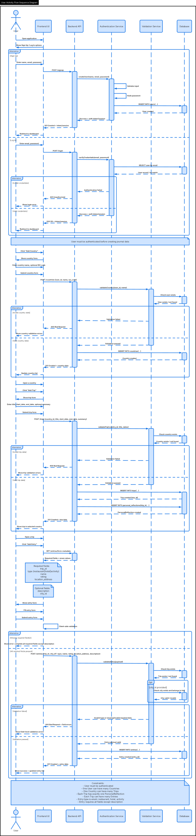
Sequence Diagram

